Slide 1
Look, Listen, Be Safe!
A student’s guide to DC Streetcar

Slide 2
Presentation Outline
DC Streetcar Overview
Look, Listen, Be Safe!
Connect with DC Streetcar

Slide 3
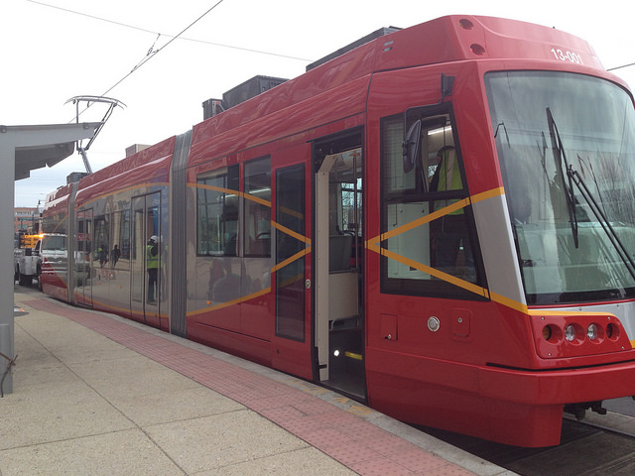
DC has a new way to travel!
“Welcome
DC Streetcar!”

Slide 4
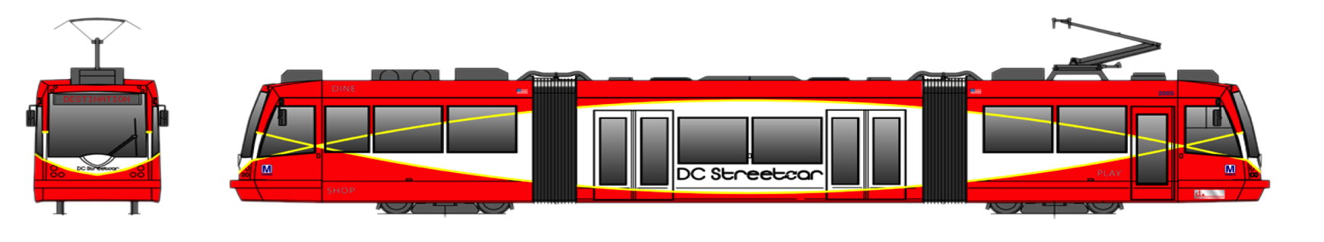
DC Streetcar Overview

Slide 5
What is a streetcar?
A streetcar is a small railroad car that moves on tracks embedded in the city streets and is used to carry passengers. Streetcars are powered by electricity.

Slide 6
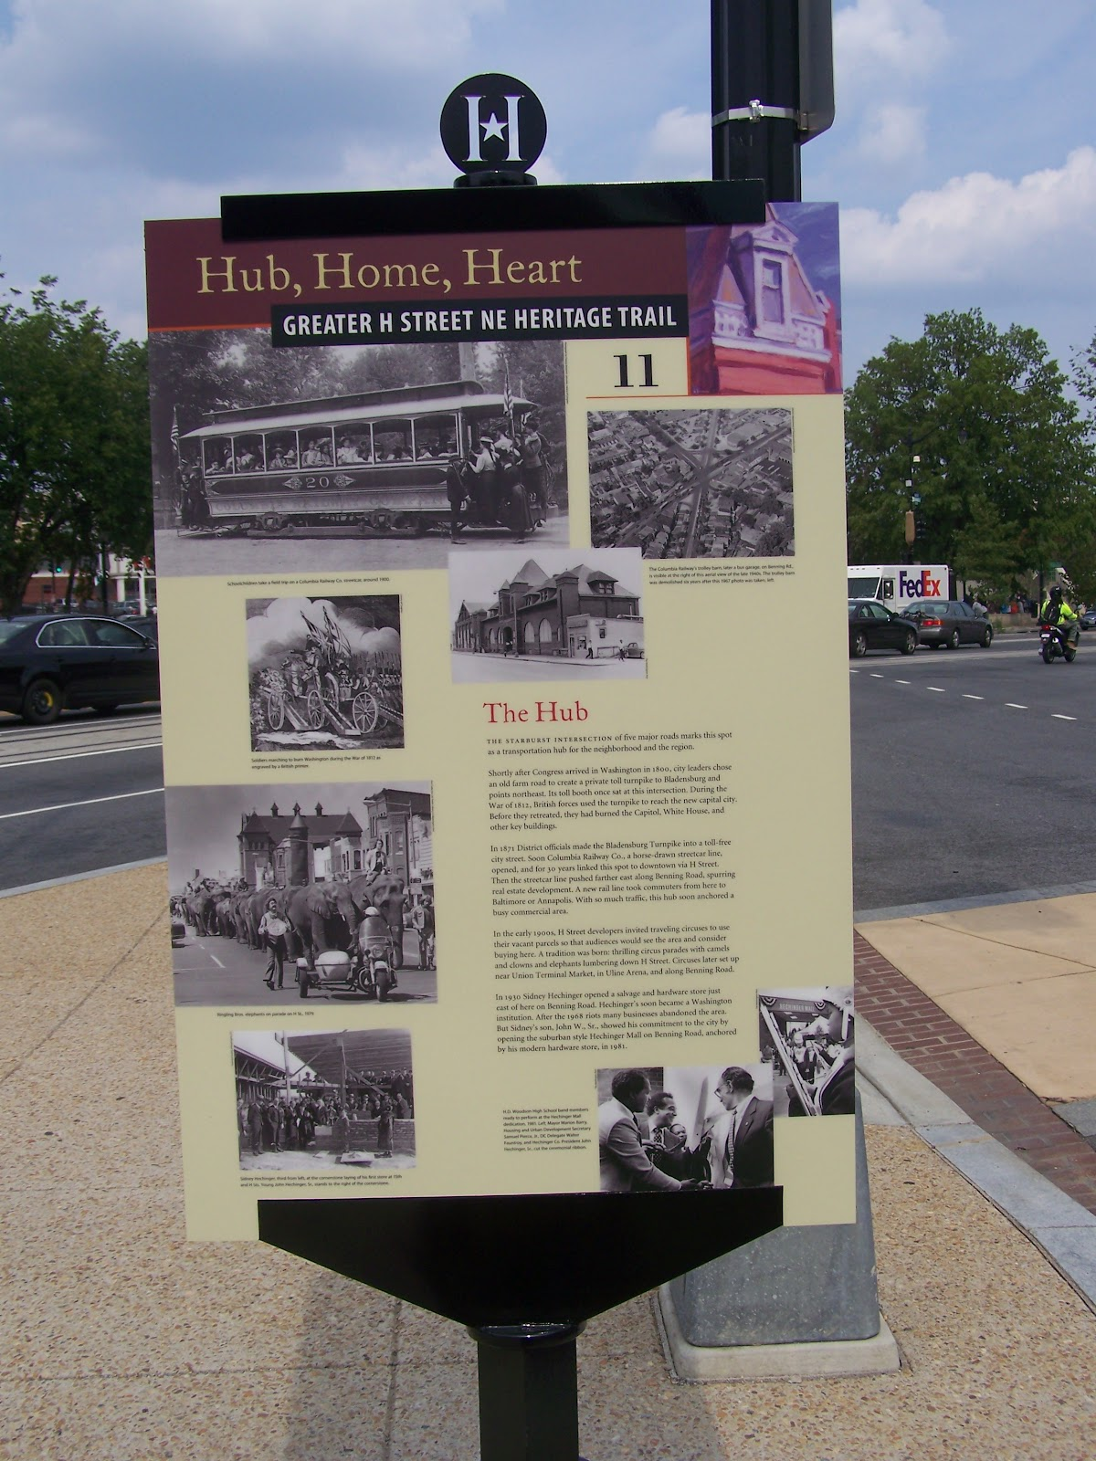
Streetcars aren’t new to H Street NE
The Columbia Railway Co. began operating a horse-drawn streetcar line along H Street in 1872. They switched to electric streetcars in 1899. The streetcar service ended on H Street in 1949.

Slide 7
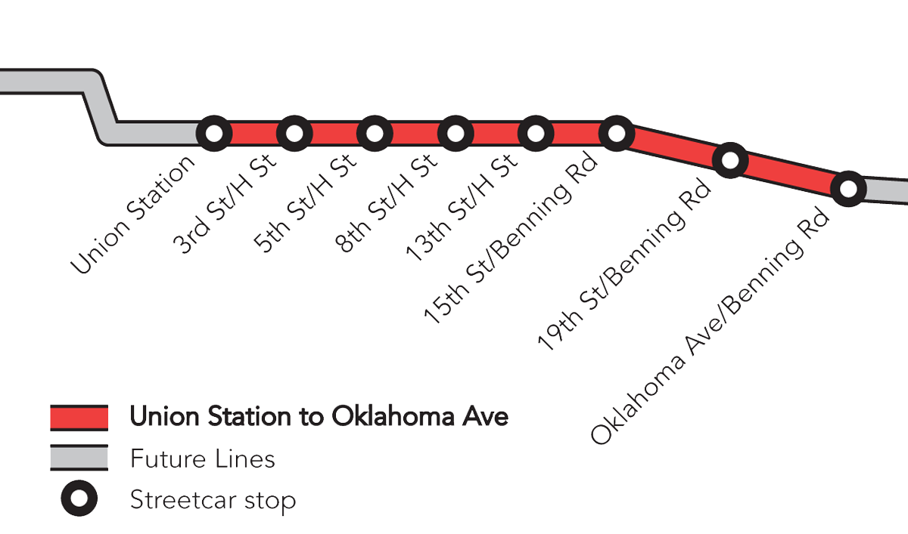
Streetcars are powered by electricity!
Substations are safe, enclosed systems that send electricity to the streetcars through the Overhead Catenary System. Three substations will be used for the H/Benning Line.
The Midline substation will be at the northwest corner of H and 12th Streets NE.
CBTC
The Western substation will be located under
the Hopscotch Bridge near Union Station.
The Eastern substation will be located on the grounds of the Car Barn Training Center (CBTC).

Slide 8
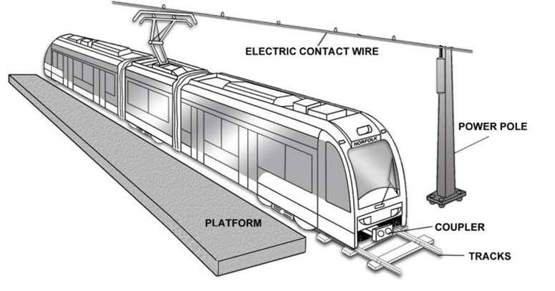
Overhead Catenary System
Streetcars pick up the electricity from the contact wires. The pantograph transfers the electricity from
the wires to the motors that drive the wheels on
the tracks.
PANTOGRAPH

Slide 9
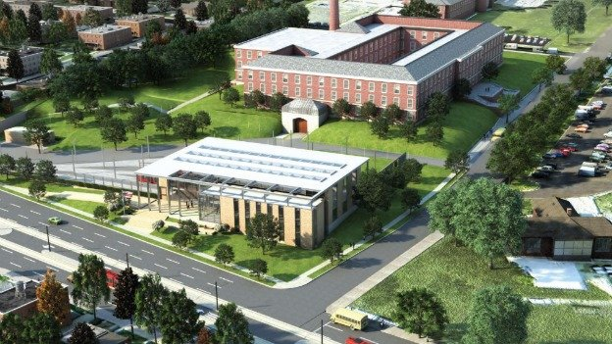
What is the Car Barn Training Center?
The Car Barn will also house a Training Center to prepare high school and college students for a career in electric vehicle technology and transit systems.
Streetcars are inspected, cleaned and repaired in the Car Barn.
Benning Road NE
26th Street NE

Slide 10
Where does the
DC Streetcar go?
The Union Station to Oklahoma Avenue Line is a 2.4-mile segment along H Street and Benning Road NE.
It serves anyone
who wants to travel
between Union Station
on the west and the
Anacostia River on
the east.

Slide 11
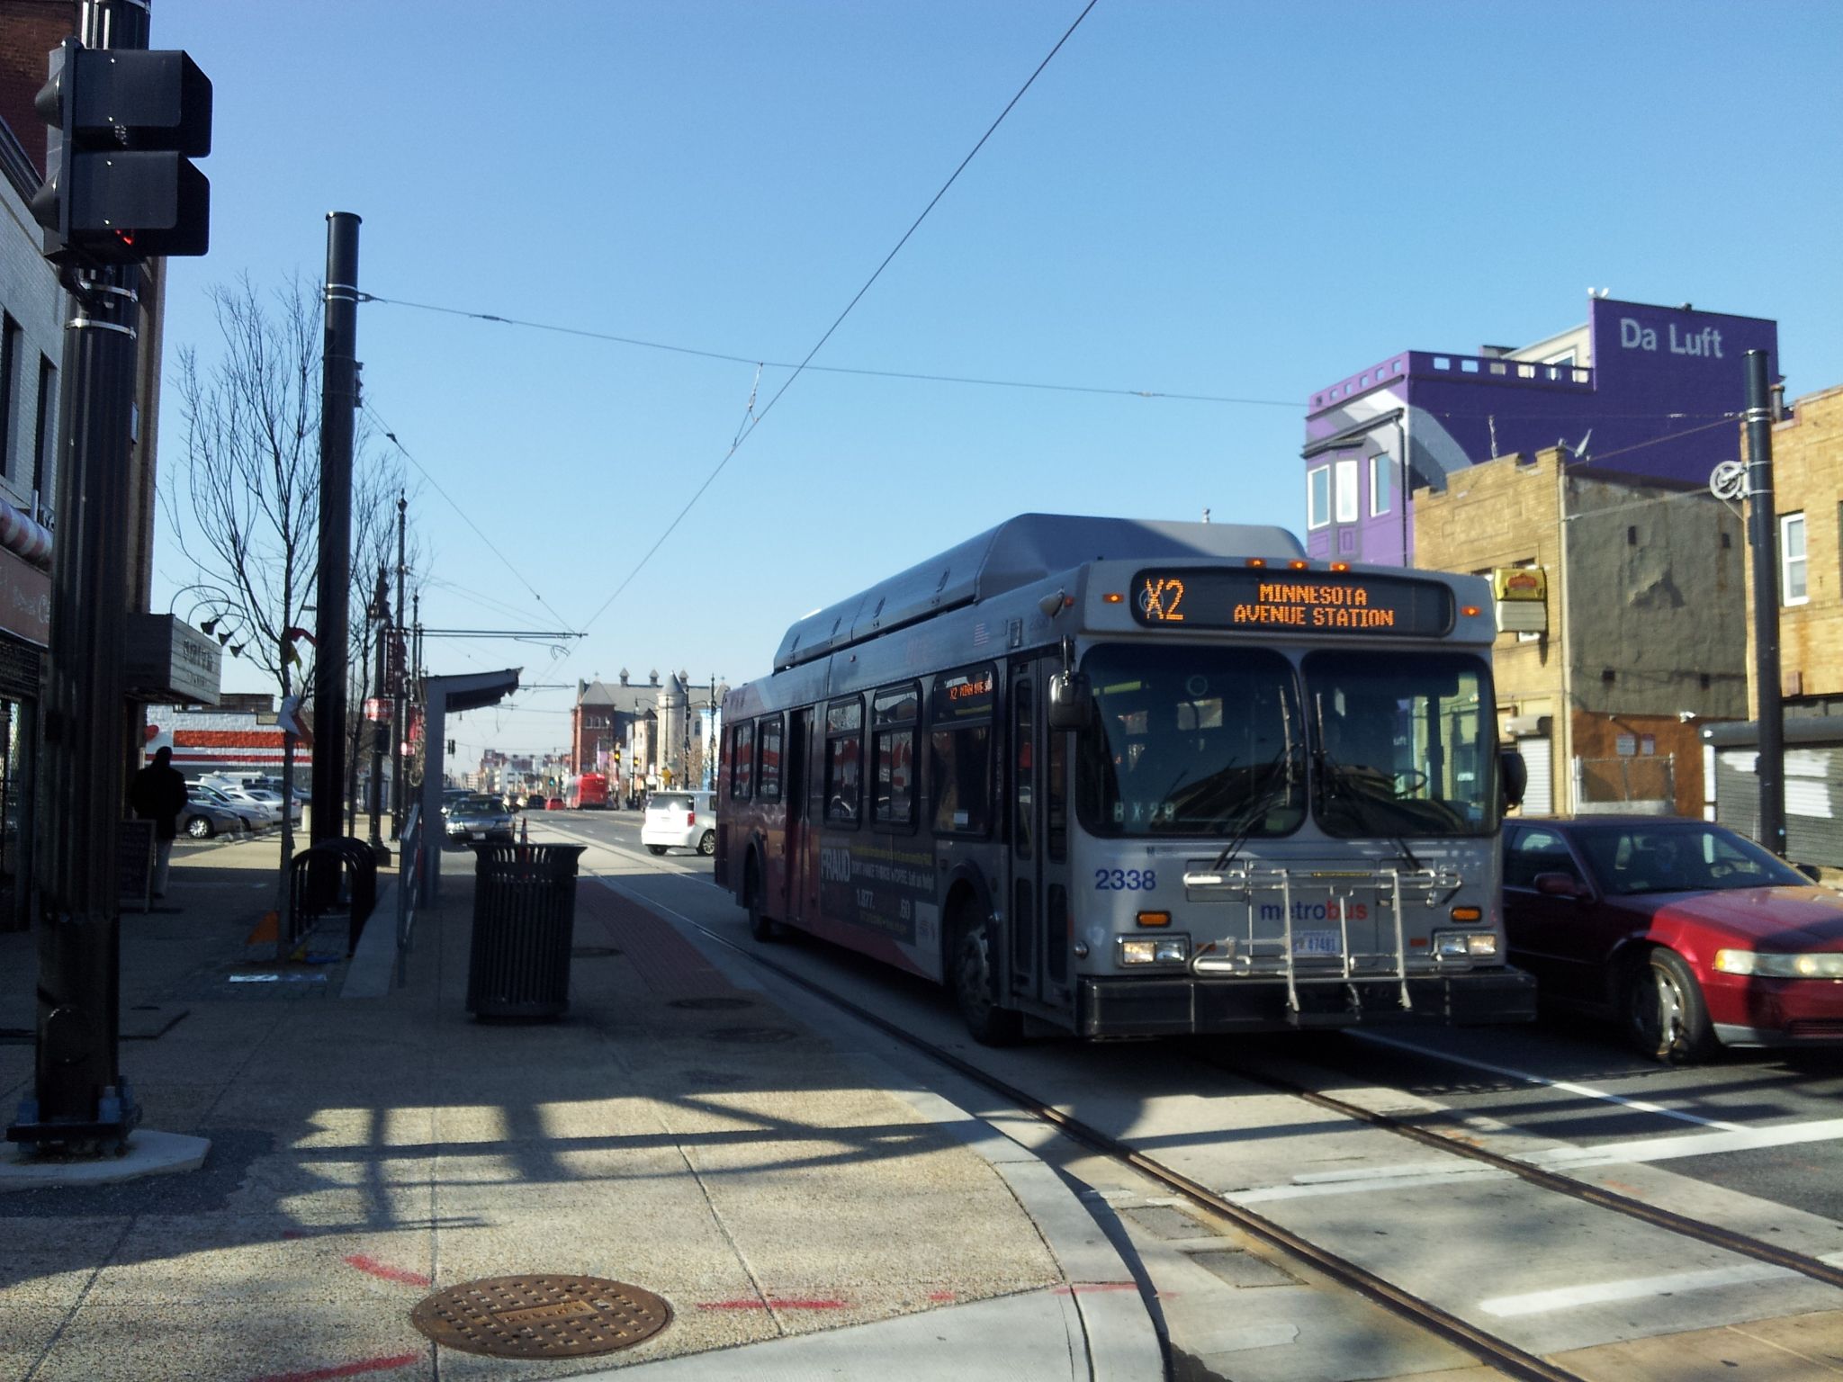
Where will streetcars be driven?
Streetcars share the streets with other vehicles. Streetcars drive in the lane where the tracks have been embedded. Buses, cars, and trucks can drive in this lane too.

Slide 12
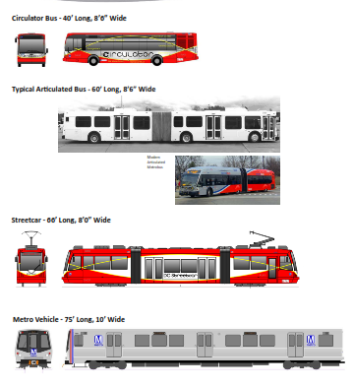
Comparison to other Transit Vehicles
Circulator bus: 49 passengers
Articulated bus: 94 passengers
Streetcar: 157 passengers
Metrocar: 120 passengers

Slide 13
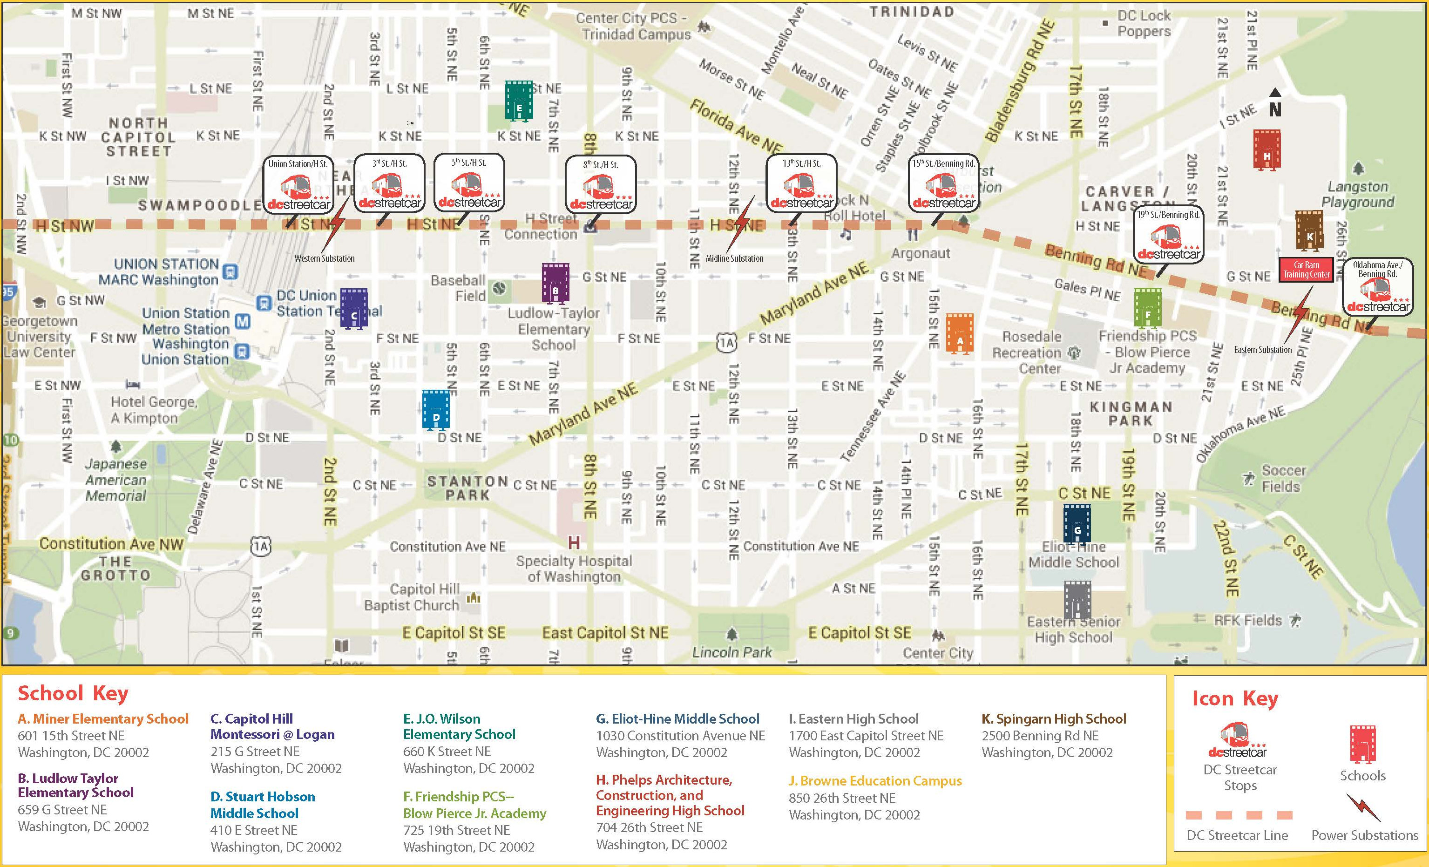
Follow the dotted line
Can you walk to your school
from the nearest DC Streetcar stop?

Slide 14
Look, Listen, Be Safe!

Slide 15
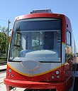
LOOK!
Always look both ways before crossing the tracks. Never cross in front of a moving streetcar, bus, or car.
Obey signs and traffic signals.

Slide 16
LISTEN!
Pause your conversation when using headphones or mobile devices near streetcar tracks.
The streetcar rings a distinctive bell as it approaches a station stop. Listen for it.

Slide 17
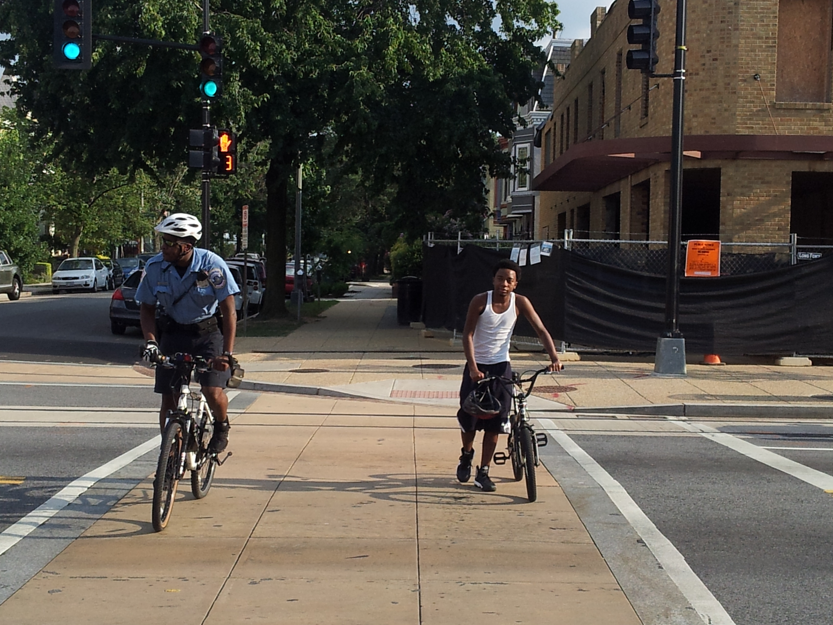
BE SAFE!
Never cross or run in front of an approaching streetcar or between two stopped vehicles.
Wait until traffic has stopped before crossing and only cross at designated crosswalks. Never assume a driver sees you.

Slide 18
Connect with DC Streetcar

Slide 19
Connect with DC Streetcar
Website: DCStreetcar.com
Phone: (855) 413-2954
E-mail: info@dcstreetcar.com
Social Media:
Facebook (facebook.com/dcstreetcar)
Twitter (twitter.com/dcstreetcar)
YouTube (youtube.com/user/DDOTVideos)
Sign Up for Our Mailing List:
Get the latest information delivered straight to your inbox. Don’t worry; we will never share your email address with anyone else. Visit dcstreetcar.com/connect/
Flickr (flickr.com/photos/dcstreetcar)
Instagram (instagram.com/dcstreetcar)

Slide 20
Thank You!
Your safety is our #1 priority.
Please do your part to be safe.
Brought to you by the District Department of Transportation

